Slide 1
Activity 1: Phone Orientation
aka: Turn that Frown Upside Down

Slide 2
Inputs Available on Smartphones
iPhone
Android

Slide 3
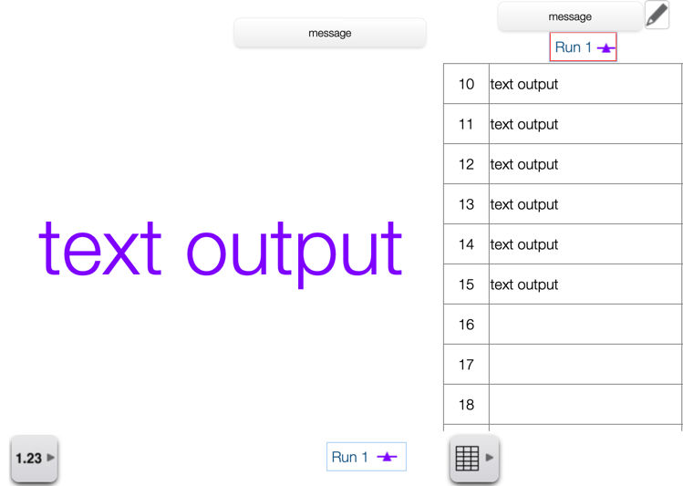
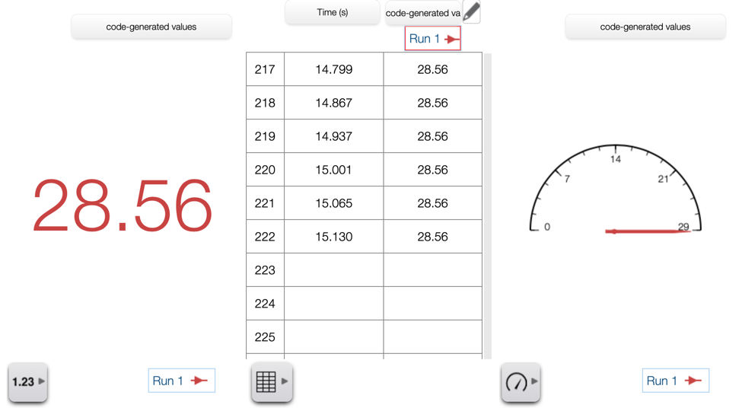
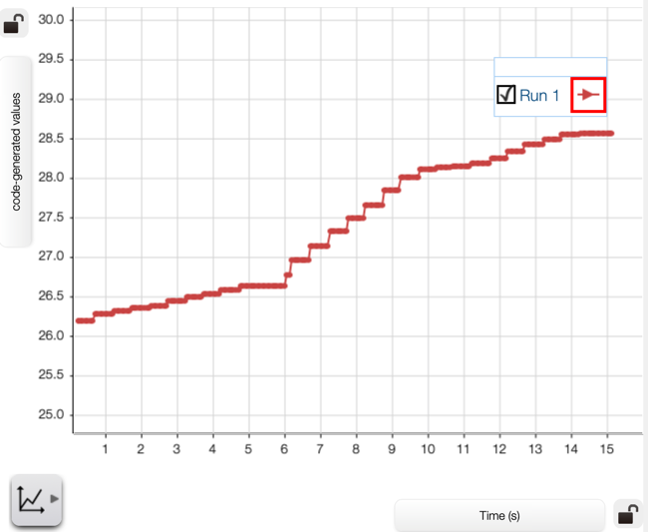
Outputs within SPARKvue
text
numerical
Notes:
note whole other category of physical outputs with the right PASCO hardware: lights, speakers, motors, fans, ballistic cart

Slide 4
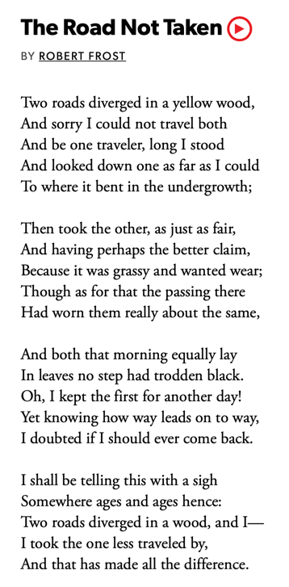
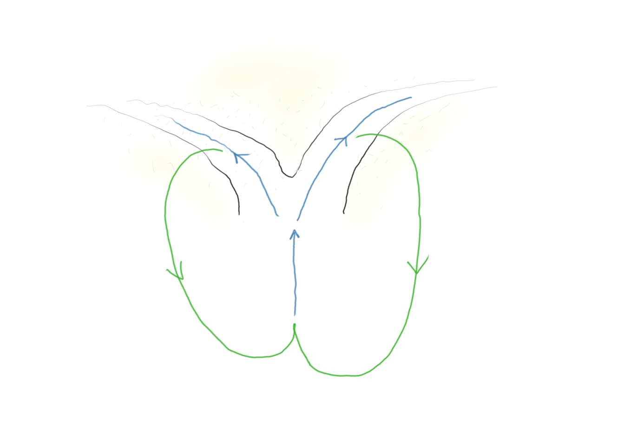
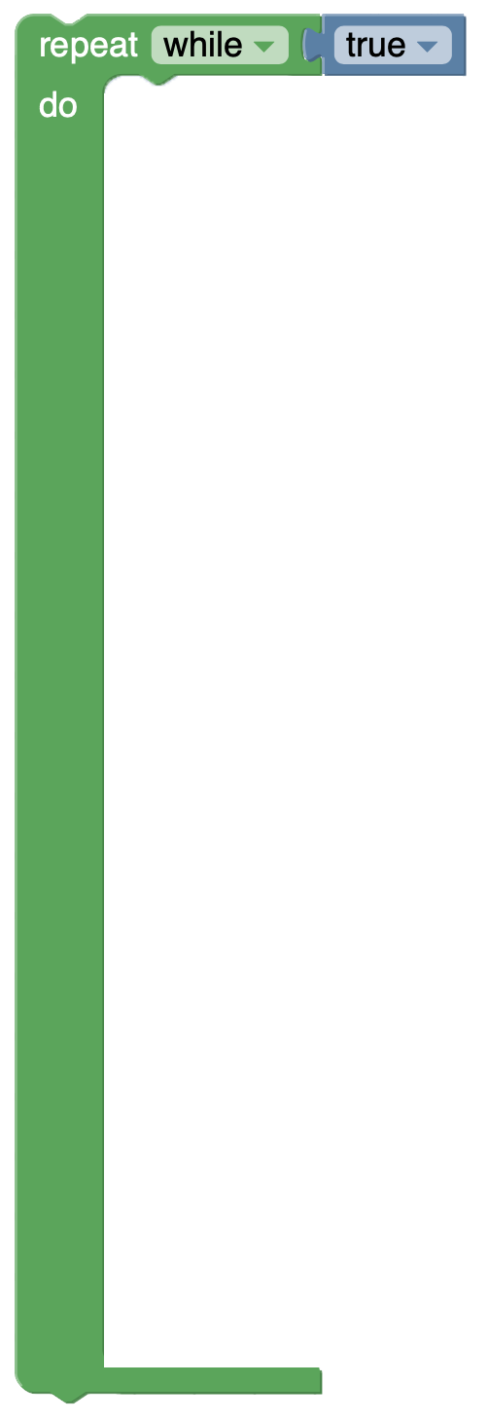
Program Flow
Notes:
The Road Not Taken
BY ROBERT FROST
Two roads diverged in a yellow wood,
And sorry I could not travel both
And be one traveler, long I stood
And looked down one as far as I could
To where it bent in the undergrowth;
Then took the other, as just as fair,
And having perhaps the better claim,
Because it was grassy and wanted wear;
Though as for that the passing there
Had worn them really about the same,
And both that morning equally lay
In leaves no step had trodden black.
Oh, I kept the first for another day!
Yet knowing how way leads on to way,
I doubted if I should ever come back.
I shall be telling this with a sigh
Somewhere ages and ages hence:
Two roads diverged in a wood, and I—
I took the one less traveled by,
And that has made all the difference.

Slide 5
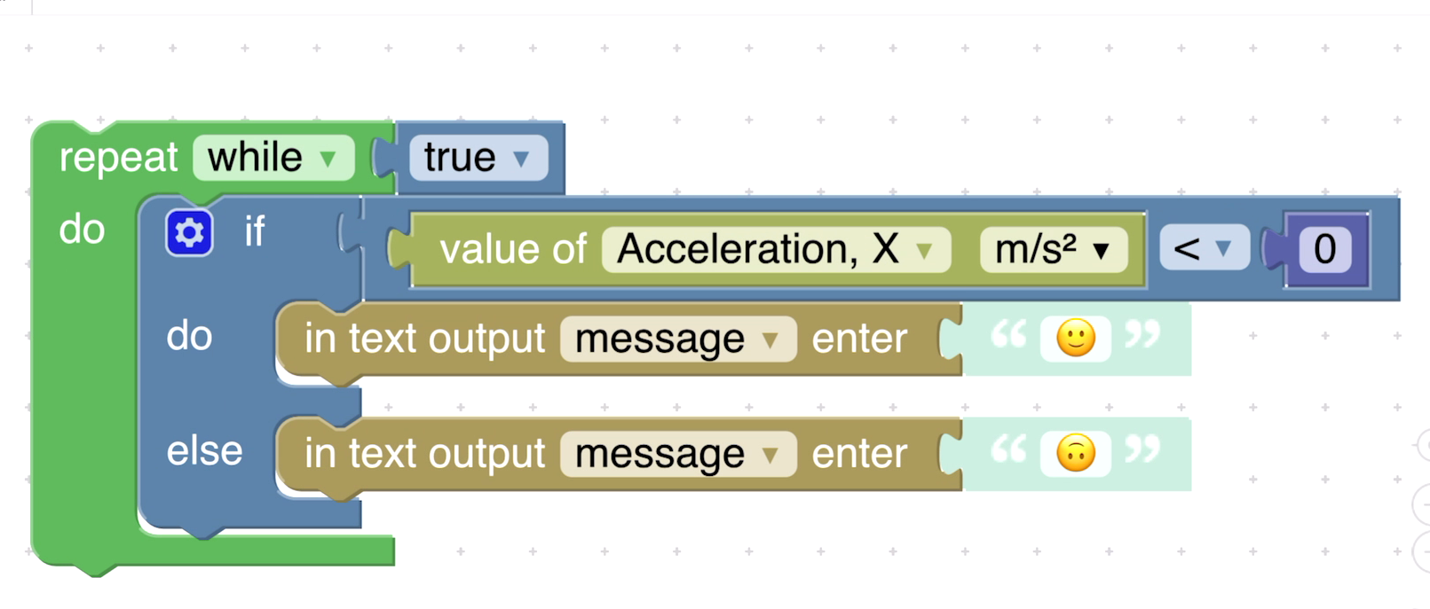
Phone Orientation Final Code

Slide 6
Additional Ideas with Phone Sensors
Acceleration
pendulum timer
step counter
digital protractor/inclinometer
(visual) motion/burgler alarm
shake detector (→ dice or Magic 8 Ball)
handwashing timer
freefall detector (careful!)
cart bumper design tester (careful!)
visual accelerometer
rolling wheel rotation → speed calculator
righthand rule indicator
dead reckoning position estimation
reaction timer (via tap)
motion-driven emoji-animated storytelling
Sound Level
classroom loudness monitor
visual loudness mapping w/ multiple phones
acoustic stopwatch
clap on | clap off
dog bark “translator”
sound-driven emoji-animated storytelling
Light (Android)
pendulum timer
fridge door opening counter
GPS (Android)
Geocaching guidance
compass heading indicator
hike elevation gained/lost monitor
car speeding (visual) alarm
Notes:
extend phone rotation activity (eg: sick after 10 flips) or these additional ideas
consider the additional possibilities of using multiple of these measurements simultaneously

